Slide 1
Image Processing and Computer Vision with Python & OpenCV

Slide 2


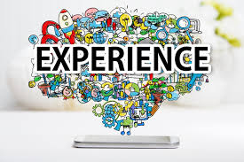

About Me
Name: Shiv
BSc and MSc in Mathematics from IIT Kharagpur,
India
PhD in Analytics
Experience: 19 years (9 Years in Analytics and 10 years in IT)
Current Role: Chief Data Scientist

Slide 3
Prerequisites
Methodology
Knowledge of Python (Basic)
Knowledge of basic Statistics
Expert in NumPy package
Awareness of ML (Nice to have in for Data Science professional)
Awareness of DL (Nice to have in for Data Science professional)
Good Knowledge of any programming technology
Ideal count of trainee 10 (classroom or webex)
Take any course similar to following
AI, Basic Statistics, Basic Python, Basic R, ML (Overview)
https://www.udemy.com/ai-basic-statistics-basic-python-basic-r-ml-overview/?couponCode=AISPYRML
Data science for AI and Machine learning using Python
https://www.udemy.com/data-scientist-for-ai-and-machine-learning-using-python/?couponCode=AIMLPY
Deep Learning by TensorFlow (tf.keras) & Keras using Python
https://www.udemy.com/deep-learning-by-tensorflow-tfkeras-keras-using-python/?couponCode=DLPY010

Slide 4
Training Content (Hands on marked in green color)
Part 1: Foundation
Technology - Skimage and OpenCV-Python Definition of image processing Definition of Computer vision Explanation of Image’s attributes Black vs Grey vs Color image Color Spaces RGB HSV: Hue Saturation Value CMYK | skimage Exploration of image Boolean arithmetic on image Various image conventions 2D/3D grayscale/multichannel Example: Counting of White dots Color image manipulation Image Histograms Image Filters
Part 2: OpenCv
Exploration of image
Exploration of Video
Manipulation of Video
Draw different geometric shapes
Playing with color
Various transformations
Arithmetic on image
Overlapping of two images
GrabCut Foreground
Contours
Hu-Moments
Clustering using KMeans
Hands on marked in green color

Slide 5
Training Content (Hands on marked in green color)
Part 3/4: Advance OpenCV
Blurring Low/High pass filter Histogram equalization Morphological operations Face Detection using Haar Cascades Image/Video Denoising Feature detection Shi-Tomasi Corner Detector Features from accelerated segment test(FAST) ORB (Oriented FAST and Rotated BRIEF) corner detectors Image Segmentation (TBD) | TensorFlow Object detection Object detection on image Object detection on video/webcam Digit recognition on image/video Build model using LinearSVC Build model using Random forest Harris Corner Detector | Edge Detection First Derivative Filters Second Derivative Filters Transformations Understanding Features Extract features/key points Histogram equalization Object Detection Tensorflow Object Detection API Best Practices
Hands on marked in green color

Slide 6



Installations & Technology
Install.txt – Please follow the steps
Skimage: Well known library in Python for image processing
https://scikit-image.org/
OpenCV-Python: A Python wrapper around original C++ implementation.
https://docs.opencv.org/3.4.5/index.html
Anaconda (https://www.anaconda.com/download/) or any Python IDE
Presentations and Code are uploaded in section (1 or 2)

Slide 7
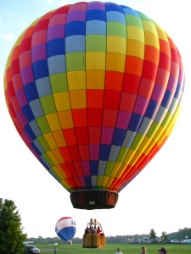
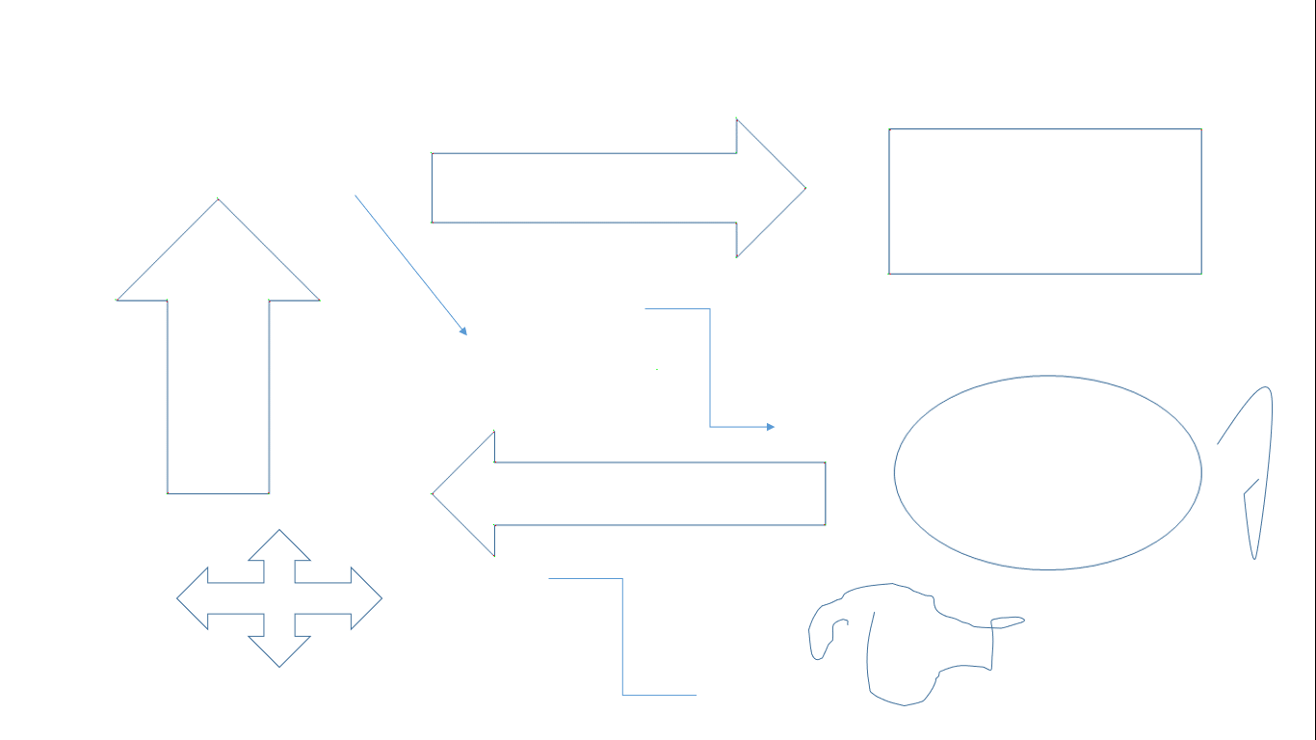
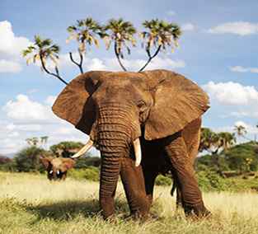

Definition of image processing
The analysis and manipulation of a digitized image, especially in order to improve its quality. As per Dictionary.com

Slide 8
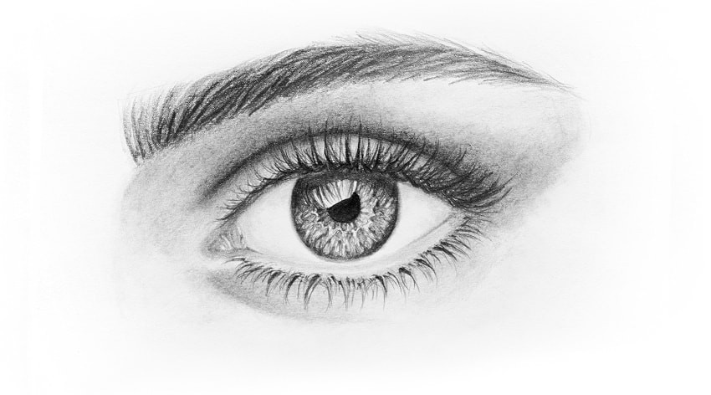
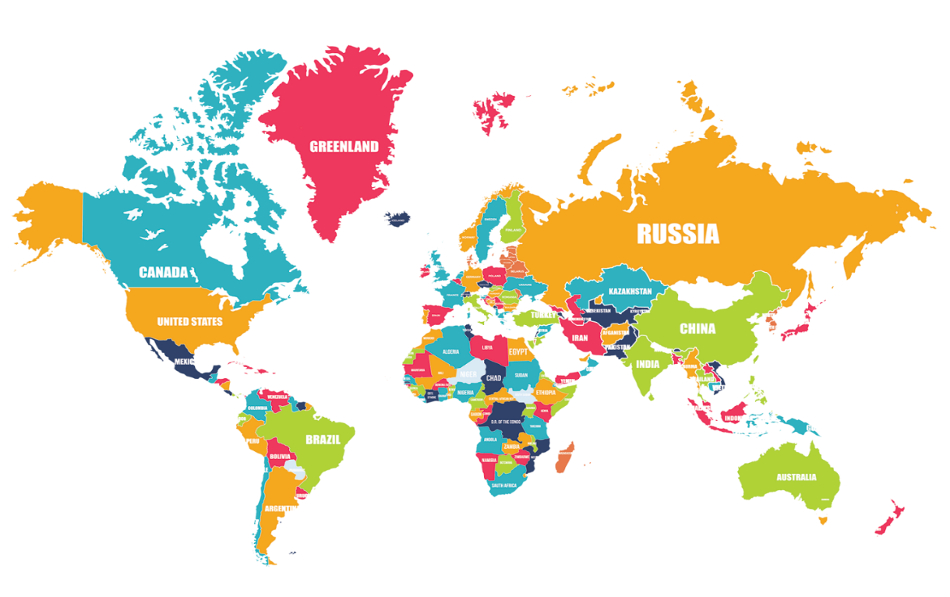
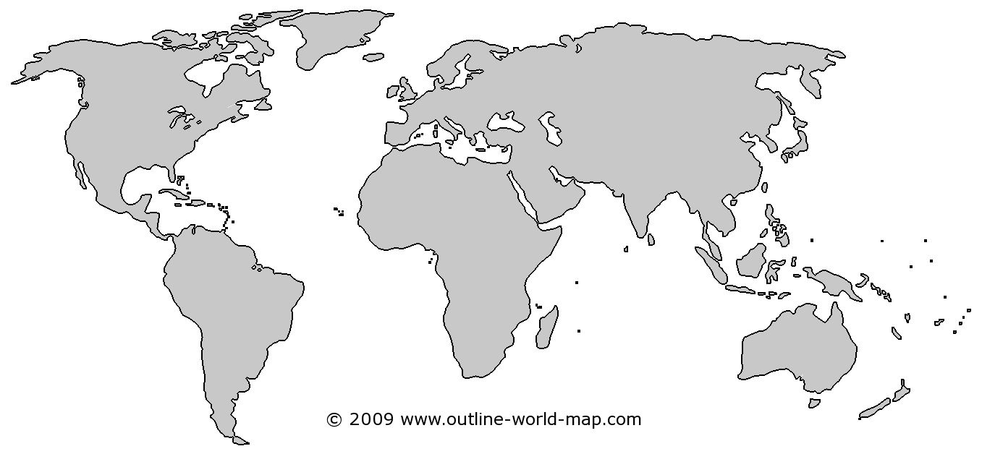
Definition of Computer vision
Process
https://en.wikipedia.org/wiki/Computer_vision
Computer vision is an interdisciplinary scientific field that deals with how computers can be made to gain high-level understanding from digital images or videos. From the perspective of engineering, it seeks to automate tasks that the human visual system can do.
Eye image source: https://ogloszenia-belgia.info/how-to-draw-eyes-sketch/7562

Slide 9
Explanation of Image’s attributes
The term pixel is generally applied to 2D and is replaced by voxel in 3D images.
Bit Depth: The pixel range of a given image format is determined by its bit depth. For example, an 8-bit image will have a range of [0; 255]. Most of the common photographic formats such as jpeg, png etc. use 8-bit for storage and only have positive values.
Medical and microscope images use a higher bit depth, as scientific applications demand higher accuracy. A 16-bit medical image will have values in the range [0; 65535].
Scientific image formats store the pixel values at high precision not only for accuracy but also to ensure that physical phenomenon that it records is not lost. In CT, for example a pixel value of > 1000 indicates bone.
There are a few image formats that store images at even higher bit-depth such as 32 or 64. For example, a jpeg image containing RGB (3 channels) will have a bit-depth of 8 for each channel and hence has a total bit-depth of 24.
A microscope image with 5 channels (say) with each channel at 16-bit depth will have a total bit-depth of 80.

Slide 10
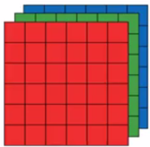

Black vs Gray vs Color image
Normal
R G B
0
255
OpenCV

Slide 11
Color Spaces - RGB
The most common color space is RGB (Red Green Blue). Each component can take a value between 0 and 255, where the tuple (0, 0, 0) represents black and (255, 255, 255) represents white, Red (255, 0, 0), Orange(255, 128, 0) and Pink (255, 153, 255)
RGB is considered an “additive” color space, and colors can be imagined as being produced from shining quantities of red, blue, and green light onto a black background.

Slide 12
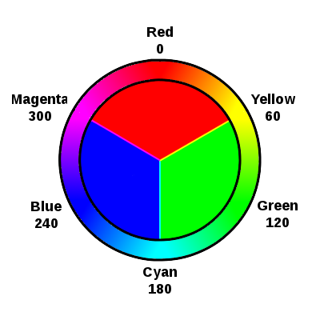
HSV: Hue Saturation Value (https://en.wikipedia.org/wiki/HSL_and_HSV)
It help to pinpoint a specific color, based on hue and saturation ranges, with a variance of value. Used in color selection tools in software and for web design
Hue for color, Saturation for the strength of the color, and Value for light
In OpenCV, Hue range is [0,179], Saturation range is [0,255] and Value range is [0,255]. Different software use different scales

Slide 13
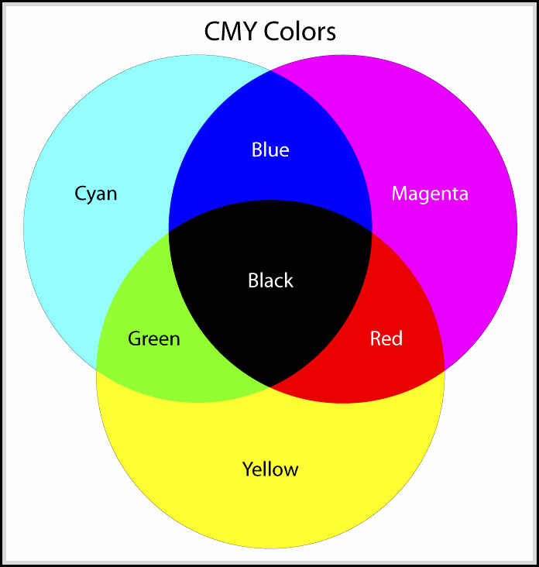
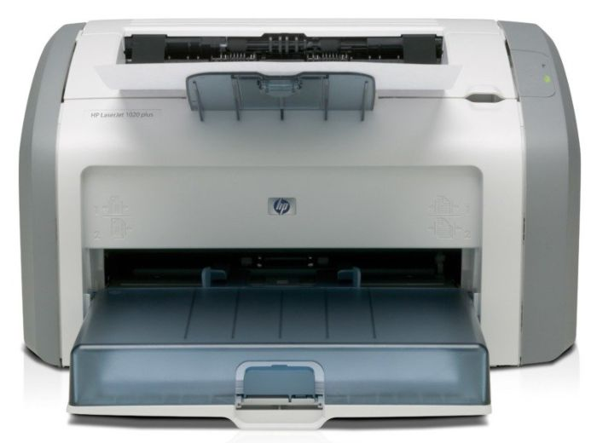
Color Spaces - cont
In the printing world, CMYK is useful because it describes the color combinations required to produce a color from a white background. While the 0 tuple in RGB is black, in CMYK the 0 tuple is white. Our printers contain ink canisters of cyan, magenta, yellow, and black.
In certain types of medical fields, glass slides mounted with stained tissue samples are scanned and saved as images. They can be analyzed in HED space, a representation of the saturations of the stain types—hematoxylin, eosin, and DAB—applied to the original tissue.
https://stodioo.com/articles/cmyk-color-model/

Slide 14
Hands on with file 1.1 image_sklearn_basics.py

Slide 15

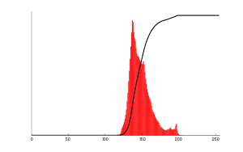
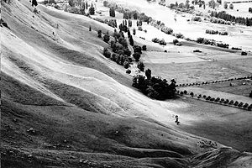
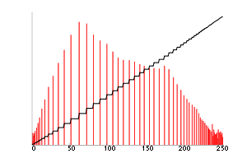
Histogram equalization
A method in image processing of contrast adjustment
This method usually increases the global contrast and hence gain lower local contrast to gain a higher contrast.
It spreads out the most frequent intensity values. (like Normalisation)
The method is useful in images with backgrounds and foregrounds that are both bright or both dark.
The calculation is not computationally intensive.
It may increase the contrast of background noise, while decreasing the usable signal.
https://en.wikipedia.org/wiki/Histogram_equalization
Corresponding histogram (red) and cumulative histogram (black)

Slide 16
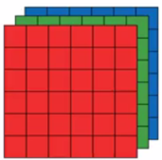
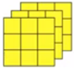
Image Filters
Filtering means - applying some visual effects to images as follows
i. Blurring, ii. Detecting edges, iii. Sharpening, iv. Enhance image contrast, v. Erode and Dilate an image (All terms will be defined in detail during hands on)
Convolution is a mathematical operation that is performed on two functions to produce a third function.
kernel is another matrix.
Following process is known as convolution.
Multiply the pixels under that kernel by the values in the kernel
Sum all the those results
Replace the top left pixel with the summed result
*
See the tab ‘convolution” in “miscellaneous.xlsx file
Types
Linear filters: Mean, Laplacian and Laplacian of Gaussian.
Nonlinear filters: Median, maximum, minimum, Sobel, Prewitt and Canny filters.

Slide 17
Hands on with file 1.2 image_sklearn_processing.py

Slide 18
Edge Detection
Edges are a set of points in an image where there is a change of intensity. From calculus, we know that the changes in intensity can be measured by using the first or second derivative.
.
Image
Intensity
.
First derivative
Second derivative
Notes:
In the transition region, since the intensity profile is increasing the first derivative is positive, while being zero in the dark and white regions. First derivative has a maximum or peak at the edge. Since the first derivative is increasing before the edge, the second derivative is positive before the edge. Likewise, since the first derivative is decreasing after the edge, the second derivative is negative after the edge. Also, second derivative is zero in dark and white regions. At the edge, the second derivative is zero. This phenomenon of the second derivative changing the sign from positive before the edge to negative after the edge or vice versa is known as zero-crossing, as it takes a value of zero at the edge.

Slide 19
First Derivative Filters
-1 | -2 | -1
0 | 0 | 0
1 | 2 | 1
Sobel filter
One of the most popular first derivative filters is the Sobel filter.
The Sobel filter or mask is used to find horizontal and vertical edges as given here
The sum of the coefficients in the mask image is 0. This means that the pixels with constant grayscale are not a affected by the derivative filter.
The side effect of derivative filters is creation of additional noise. Hence, coefficients of +2 and -2 are used in the mask image to produce smoothing
H
-1 | 0 | 1
-2 | 0 | 2
-1 | 0 | 1
V
-1 | -1 | -1
0 | 0 | 0
1 | 1 | 1
H
Prewitt filter
-1 | 0 | 1
-1 | 0 | 1
-1 | 0 | 1
The sum of the coefficients in the mask image is 0. However, the filter does not create noise as can be seen in the values of the coefficients.
V
Canny
This filter uses three parameters to detect edges. The first parameter is the standard deviation , ‘sigma’ for Gaussian filter. The second and third parameters are the threshold values, t1 and t2.
Source: Wikipedia

Slide 20
Second Derivative Filters: Laplacian filter
This filter uses three parameters to detect edges. The first parameter is the standard deviation , ‘sigma’ for Gaussian filter. The second and third parameters are the threshold values, t1 and t2.
Positive Laplacian Operator for outward edges
0 | 1 | 0
1 | -4 | 1
0 | 1 | 0
1 | 1 | 1
1 | -8 | 1
1 | 1 | 1
Negative Laplacian Operator for inward edges
0 | -1 | 0
-1 | 4 | -1
0 | -1 | 0
-1 | -1 | -1
-1 | 8 | -1
-1 | -1 | -1

Slide 21
Hands on with file 2.1 image_opencv_basics.py

Slide 22
Transformations
Euclidean transformations
Affine transformations
Euclidean transformations
Affine
transformations
Similarity transformations
Similarity transformations
Notes:
An affine transformation is any transformation that preserves collinearity (i.e., all points lying on a line initially still lie on a line after transformation) and ratios of distances (e.g., the midpoint of a line segment remains the midpoint after transformation).

Slide 23
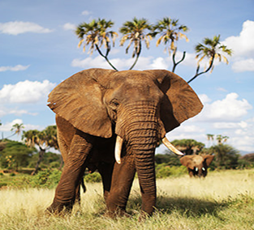
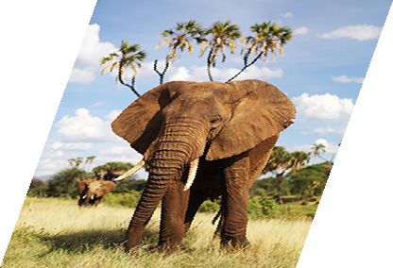
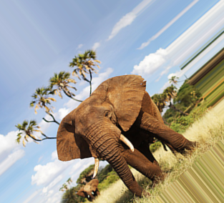
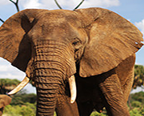
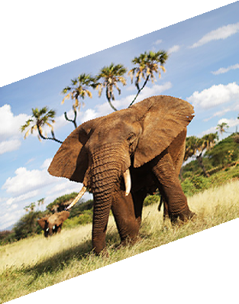
Data Augmentation
Original
Flip Horizontal
Resize Horizontal
Random transformation
Cropping
Resize Vertical

Slide 24
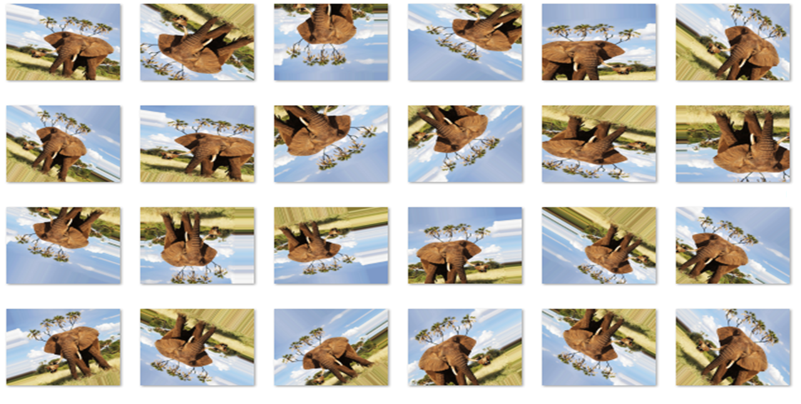
Data Augmentation cont

Slide 25
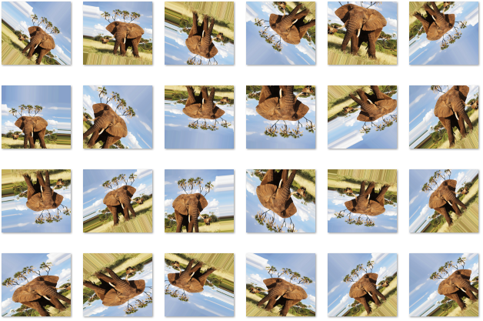
Data Augmentation cont

Slide 26
Hands on with file 2.2 image_opencv_filtering.py

Slide 27
Hands on with file 2.3 image_opencv_arithmetic.py

Slide 28
Hands on with file 2.4 image_opencv_contours.py

Slide 29
Hands on with file 3. image_opencv_face_detection.py

Slide 30
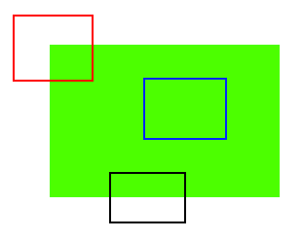
Understanding Features
See all 3 patches - blue patch (on flat area), black patch (on edge) and red patch (on corner) -> Corners are considered to be good features in an image
How do we find the corners ->Find the regions which have maximum variation when moved (by a small amount) in all regions around it -> Finding these image features is called Feature Detection.
Above will provide pattern -> Model is trained to find similar pattern in other images -> Called Feature Description -> Now model can find same features
Notes:
blue patch is flat area and difficult to find and track. Wherever you move the blue patch, it looks the same. For black patch, it is an edge. If you move it in vertical direction (i.e. along the gradient) it changes. Put along the edge (parallel to edge), it looks the same. And for red patch, it is a corner. Wherever you move the patch, it looks different, means it is unique. So basically, corners are considered to be good features in an image. (Not just corners, in some cases blobs are considered good features).

Slide 31
Few well known techniques
Harris Corner Detector (Original Paper: http://www.bmva.org/bmvc/1988/avc-88-023.pdf)
2x2 matrix based on partial derivatives of the grayscale image
Analyze the eigenvalues obtained
The high value of eigenvalues indicates - corner point
Harris Corner with Subpixel Accuracy: To find the corners with maximum accuracy. It uses centroids (of bunch of pixels at a corner) to refine them. Harris corners are marked in red pixels and refined corners are marked in green pixels in code
ORB is basically a fusion of FAST key point detector and BRIEF descriptor with many modifications to enhance the performance. First it use FAST to find key points, then apply Harris corner measure to find top N points among them.
ORB (Oriented FAST and Rotated BRIEF): it is a good alternative to SIFT and SURF in computation cost, matching performance and mainly the patents. Yes, SIFT and SURF are patented and you are supposed to pay them for its use. But ORB is not ☺

Slide 32
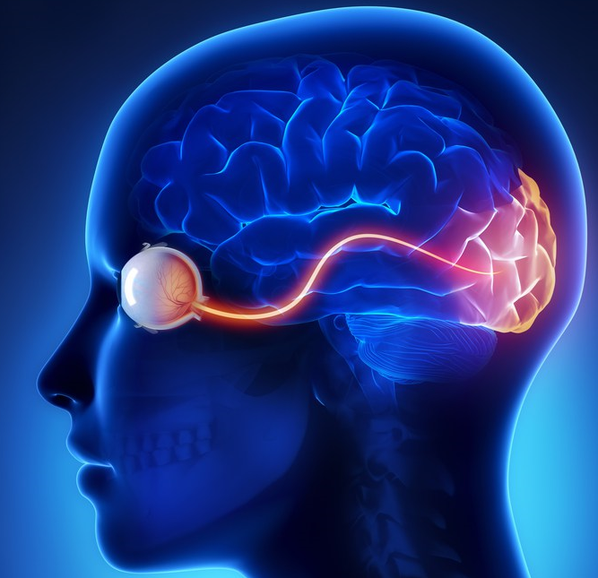
Extract features/key points
How humans do it. Our brain is an extremely powerful machine that can do complicated things very quickly. When we look at something, our brain automatically creates a footprint based on the interesting aspects of that image.
https://discoveryeye.org/optic-nerve-visual-link-brain/

Slide 33
Extract features/key points: Blank image
http://www.outline-world-map.com/blank-world-maps-solid

Slide 34
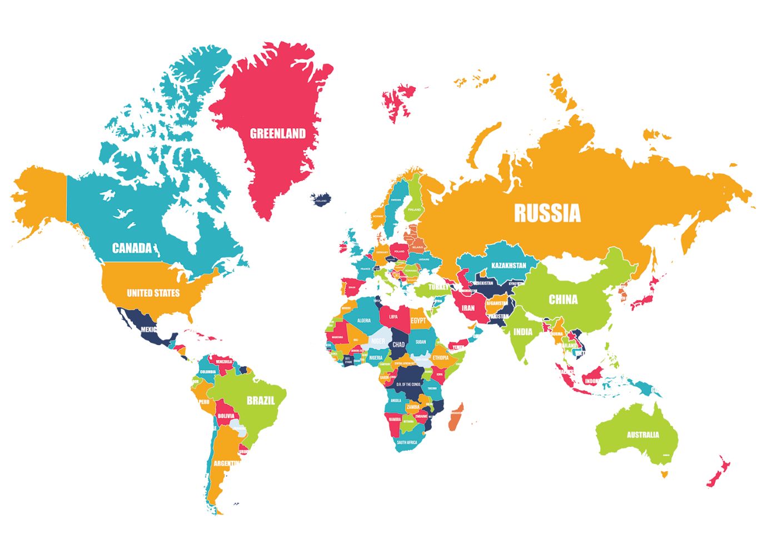
Extract features/key points: Color image

Slide 35
Extract features/key points: What do you see?
distinct

Slide 36
Hands on with file 4. image_opencv_feature_detection.py

Slide 37
Hands on with file 5. image_opencv_image_matching.py

Slide 38
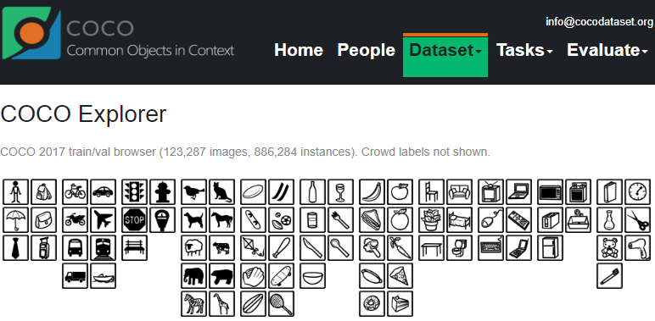
Tensorflow Object Detection API
he API has been trained on the COCO dataset (Common Objects in Context) (http://cocodataset.org/). This is a dataset of 300k images of 90 most commonly found objects. Examples of objects includes:

Slide 39
Install steps are in ‘install.txt’. Please see section ‘TensorFlow Object detection’
Hands on with file 6. image_tensorflow_object_detection.py

Slide 40
Hands on with file 7. image_digit_recognition.py

Slide 41
8. image_opencv_segmentation.py

Slide 42
Miscellaneous

Slide 43
Definitions
Morphological operations are the set of operations that process images according to their shapes.
Erosion: Erosion is quite a similar process as dilation. But the pixel value computed here is minimum rather than maximum in dilation. The image is replaced under the anchor point with that minimum pixel value. With this procedure, the areas of dark regions grow in size and bright regions reduce. For example, the size of an object in dark shade or black shade increases, while it decreases in white shade or bright shade.
Dilation: This procedure follows convolution with some kernel of a specific shape such as a square or a circle. This kernel has an anchor point, which denotes its center. This kernel is overlapped over the picture to compute maximum pixel value. After calculating, the picture is replaced with anchor at the center. With this procedure, the areas of bright regions grow in size and hence the image size increases.
HOG is a feature extraction technique. That means HOG is a compressed & encoded version of your image.
https://www.quora.com/What-are-HOG-features-in-computer-vision-in-laymans-terms

Slide 44
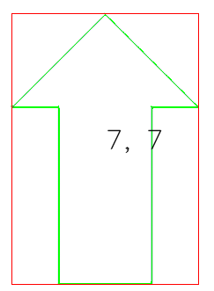
Definitions cont
Contours: it is set of boundaries of all the shapes that are found in the image. Contour analysis is a very useful tool in the field of computer vision. We deal with a lot of shapes in the real world, and contour analysis helps in analyzing those shapes using various algorithms.
Convex (curves which are always bulged out or at-least flat) shapes (also known as Closed shapes) : For any two points within shapes and draw a line between them, and that line will always lie within that shape.
Convex hull:
Solidity factor: It is the ratio of the area of shape to the area of the convex hull. This metric will have a lower value for the irregular shapes because of the empty area that will be left out.
Convexity defect: Any deviation of the object from convex hull

Slide 45
Best Practices
Start with image and then move to Video
To speed up video – process 1 frame per 29 frames (say 1sec)
Infrastructure – as high as possible

Slide 46
Do you know Everything?

Slide 47
Seam carving
https://en.wikipedia.org/wiki/Seam_carving
Paper: http://dl.acm.org/citation.cfm?id=1276390

Slide 48
References
https://opencv-python-tutroals.readthedocs.io/en/latest/py_tutorials/py_setup/py_intro/py_intro.html#introhttps://realpython.com/tutorials/computer-vision/
https://www.pyimagesearch.com/
https://pythonspot.com/vision/
https://courses.learnopencv.com/p/opencv-for-beginners
https://www.tensorflow.org/api_guides/python/image
https://docs.opencv.org/3.4.5/d3/d05/tutorial_py_table_of_contents_contours.html
https://en.wikipedia.org/wiki/Image_moment
https://en.wikipedia.org/wiki/Histogram_equalization
OpenCV 3.x with Python By Example by Gabriel Garrido and Prateek Joshi
https://docs.opencv.org/3.4.5/d0/d86/tutorial_py_image_arithmetics.html
https://pythonprogramming.net/image-arithmetics-logic-python-opencv-tutorial/
HSV color range: http://answers.opencv.org/question/100647/how-to-remove-green-color-ie-to-set-it-to-0-in-an-image/
https://stackoverflow.com/questions/10948589/choosing-the-correct-upper-and-lower-hsv-boundaries-for-color-detection-withcv
https://pythonprogramming.net/grabcut-foreground-extraction-python-opencv-tutorial/
http://www.ritsumei.ac.jp/~akitaoka/index-e.html
https://tensorflow-object-detection-api-tutorial.readthedocs.io/en/latest/index.html
https://www.pyimagesearch.com/2014/09/15/python-compare-two-images/
http://scikit-image.org/docs/dev/auto_examples/features_detection/plot_blob.html#sphx-glr-auto-examples-features-detection-plot-blob-py
http://scikit-image.org/docs/dev/auto_examples/segmentation/plot_chan_vese.html#sphx-glr-auto-examples-segmentation-plot-chan-vese-py
http://scikit-image.org/docs/dev/auto_examples/
https://github.com/scikit-image/skimage-tutorials/tree/master/
https://www.pyimagesearch.com/pyimagesearch-gurus/

Slide 49
References
Using TensorFlow: https://tensorflow-object-detection-api-tutorial.readthedocs.io/en/latest/index.html
#Using retinanet -> https://www.analyticsvidhya.com/blog/2018/06/understanding-building-object-detection-model-python/?utm_source=feedburner&utm_medium=email&utm_campaign=Feed%3A+AnalyticsVidhya+%28Analytics+Vidhya%29
# Using retinanet https://github.com/OlafenwaMoses/ImageAI/releases/download/1.0/resnet50_coco_best_v2.0.1.h5
#and ImageAI pip install https://github.com/OlafenwaMoses/ImageAI/releases/download/2.0.1/imageai-2.0.1-py3-none-any.whl

